Slide 1


The impact of new FDI screening rules in the Nordics and baltics
24 August 2021

Slide 2
International business law firm
MAGNUSSON COUNTRIES
BUSINESS GROUPS & OTHER
AREAS OF INTEREST

Slide 3
FDI SCREENING
IN The BALtics
24 August 2021

Slide 4
Background for the Existing and new rules
Baltics are different
Historic context - 30 years ago, full control of any foreign investment
Dynamics from real estate towards technology, Prudential Ownership Control in Financial Sector,
EU Screening Regulation (Regulation (EU) 2019/452) (March 2019) – Delicate and not harmonizing
Guidance to the Member States concerning foreign direct investment and free movement of capital from third countries, and the protection of Europe’s strategic assets, ahead of the application of Regulation (EU) 2019/452 (FDI Screening Regulation) (March 2020) – Strong endorsement

Slide 5
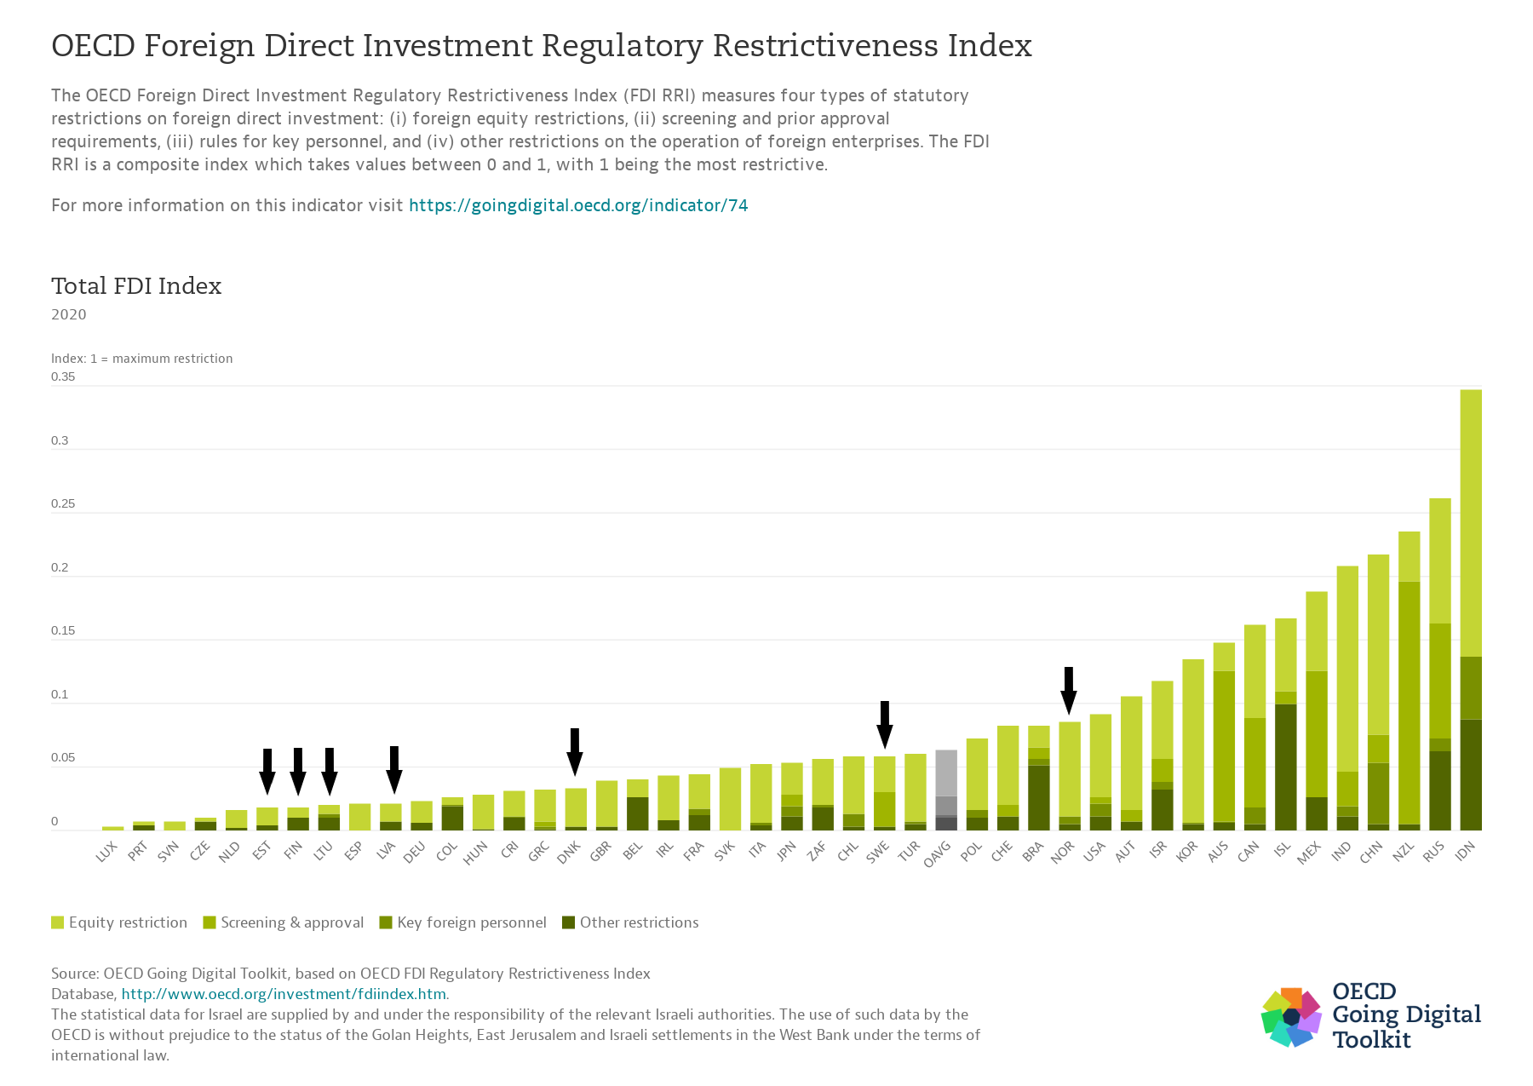

Slide 6
Notification to the commission
    Latvia - National Security Law, Chapter VI – Restrictions on Commercial Companies of Significance to National Security
            - Regulations of the Cabinet of Ministers of October 3, 2017 No. 606 “Regulations regarding the information to be submitted to the institution specified in the National Security Law and activities with information regarding foreign direct investment
    Lithuania - The Law On The Protection Of Objects Of Importance To Ensuring National Security
            - Resolution on the Determination of the Protection Zones of Importance to National Security approved by the Government
    Estonia - N/A
    Consultation, EU Commission role, Final decision always up to member state

Slide 7

Estonia
June 2021 - Legislative proposal
March 2021 - Impact Study
August/September 2021 – Draft Act

Slide 8
Estonia
the origin of the investment (ratione personae),
the nature of the investment and the threshold (ratione materiae),
the target of the investment (regulated sectors)
the review process

Slide 9
acquisition of real estate by foreigners
  Restrictions on Acquisition of Immovables Act
  Acquisition of immovables which contain agricultural or forest land
  A legal person the seat of which is in a Contracting party to the EEA Agreement or a member state of the OECD – up to 10 ha
  Restrictions on Acquisition of Immovables Arising from National Defence Reasons
  Any natural person who is not a citizen of a contracting party to the EEA Agreement or any legal person whose seat is not in a contracting party to the EEA Agreement is prohibited.

Slide 10

Latvia
The mechanism applies to commercial companies registered in Latvia which
(i) are of significance to national security (electronic communications operators with a significant market power, audible broadcasting mass media whose coverage extends at least 60% of Latvian territory or audio-visual electronic mass media whose coverage extends to at least 95% of Latvian territory, transmission, distribution, storage of natural gas, electricity or thermal energy producers with an actual capacity exceeding 50 MW or transmission and distribution operators,
(ii) operate a national critical infrastructure; or
(iii) operate a European critical infrastructure.
The Ministry of Economic Affairs maintains the list of commercial companies that qualify as “significant to national security”. Prior approval is required for transfer of (i) ownership or control in a company of significance to national security or its holding company or beneficial owner and (ii) ownership of national or European critical infrastructure.

Slide 11

Lithuania
The mechanism applies to all investors except for certain state owned or controlled entities and companies (whether by Lithuania, EU, EFTA, OECD or NATO states).
The scope and mandatory or discretionary nature of the screening mechanism differs according to the target asset and the type of transaction.
(i) economic sectors important to national security; (ii) protection zones of enterprises and facilities important to national security; (iii) enterprises important to national security, divided into Category I, II and III in decreasing order of importance; and (iv) facilities important to national security.
The screening mechanism is triggered by (i) transfer, pledging, or mortgage of facilities or property of importance to ensuring national security; (ii) acquisition independently or jointly through the acquisition of shares or agreements on the transfer of voting rights of at least 25% of the votes of a Category I or Category II enterprise; or at least one third of the votes of a Category III enterprise; or (iii) transfer, pledging or mortgage of property indicated in the security plan of an enterprise of importance to ensuring national security.

Slide 12
Final comments
  Clearly the Baltics are more focused to national security and public order, rather than new industrial policy and strategic resilience.
    Is this the end of the pendulum shift in new era of “strategic resilience”? Certainly not. Initiatives like White Paper on Foreign Subsidies, Supply Chain Sustainability will change how international business with and within EU work.

Slide 13




FDI screening in Norway
Simen Klevstrand, Partner, Haavind
Legal 500 Webinar, 24 August 2021

Slide 14
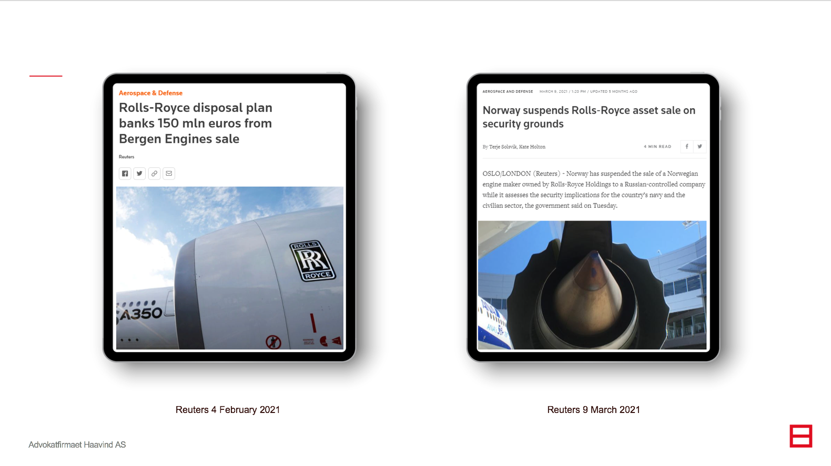

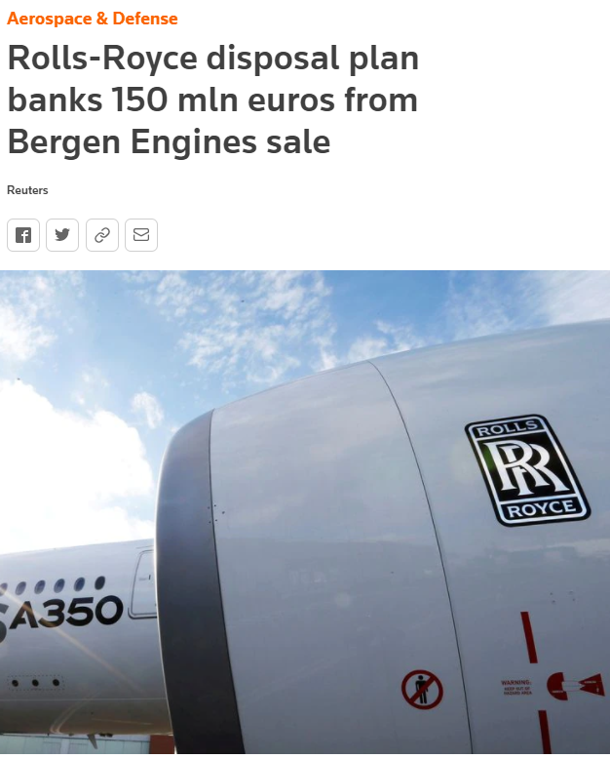
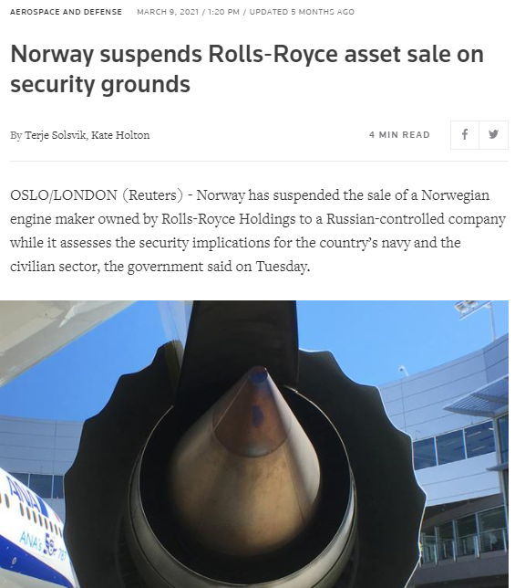
Reuters 4 February 2021
Reuters 9 March 2021

Slide 15
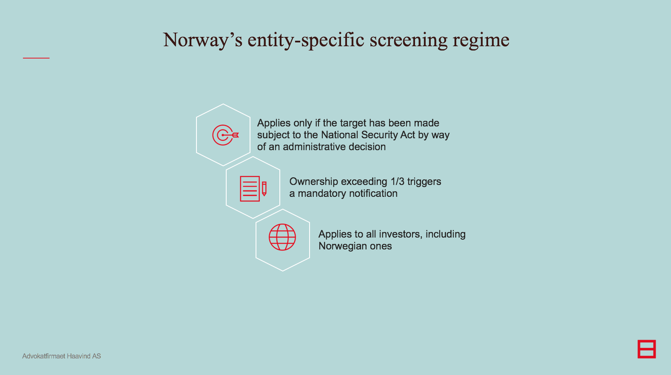




Norway’s entity-specific screening regime
Applies only if the target has been made subject to the National Security Act by way of an administrative decision
Ownership exceeding 1/3 triggers a mandatory notification
Applies to all investors, including Norwegian ones

Slide 16
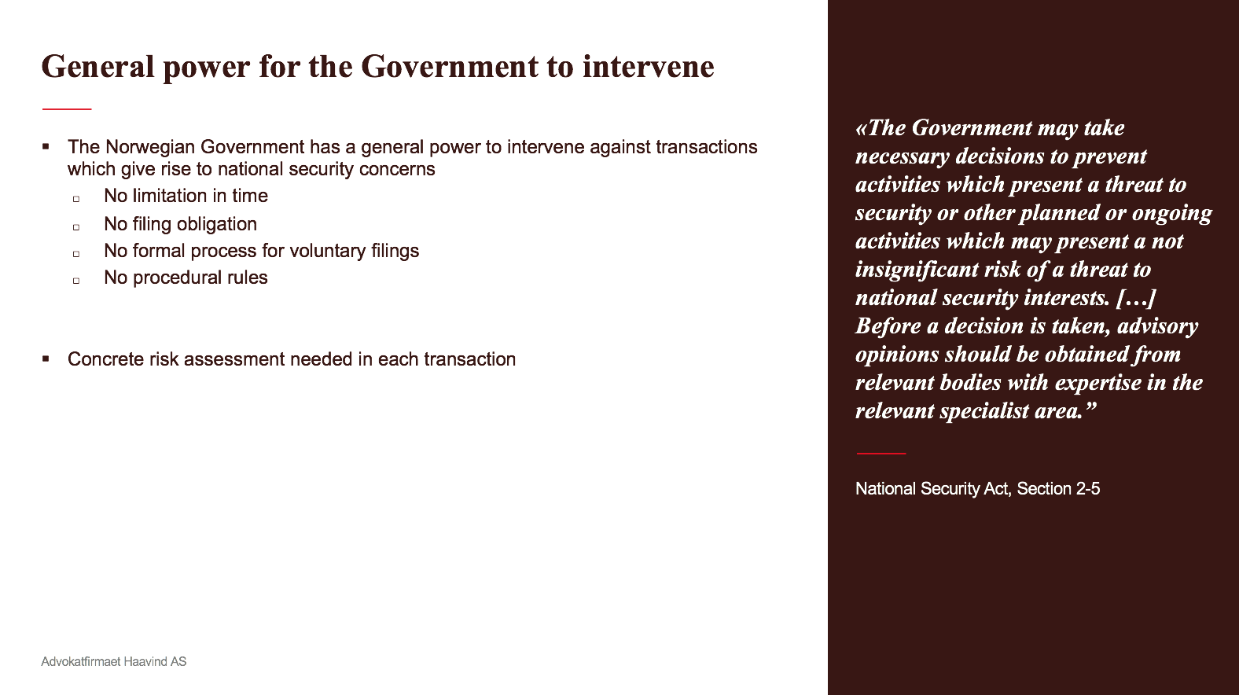
General power for the Government to intervene
«The Government may take necessary decisions to prevent activities which present a threat to security or other planned or ongoing activities which may present a not insignificant risk of a threat to national security interests. […] Before a decision is taken, advisory opinions should be obtained from relevant bodies with expertise in the relevant specialist area.”
The Norwegian Government has a general power to intervene against transactions which give rise to national security concerns
  No limitation in time
  No filing obligation
  No formal process for voluntary filings
  No procedural rules
Concrete risk assessment needed in each transaction
National Security Act, Section 2-5

Slide 17
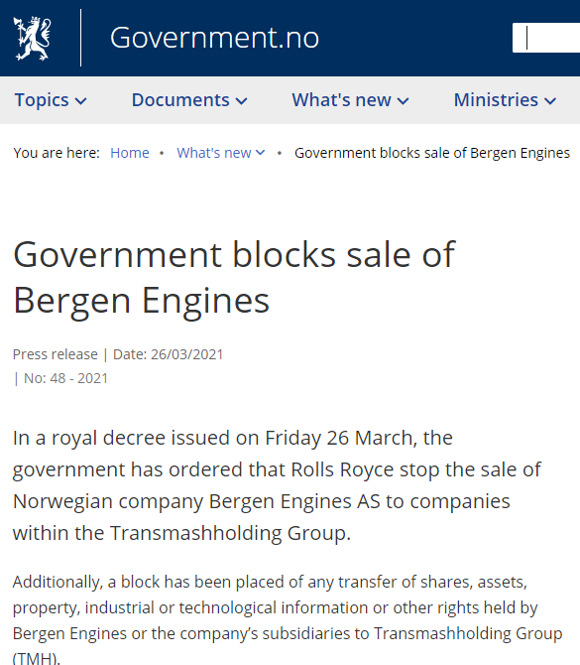
The buyer, THM Group, had ties to the Russian government.
Bergen Engines’ engines and technology “would be of great military strategic significance for Russia” (although not covered by export control rules).
Russia had faced significant challenges in gaining access to these since the imposition of sanctions against the country in 2014.
The sale included Bergen Engines’ strategically located property close to military installations.
Government press release 26 March 2021

Slide 18
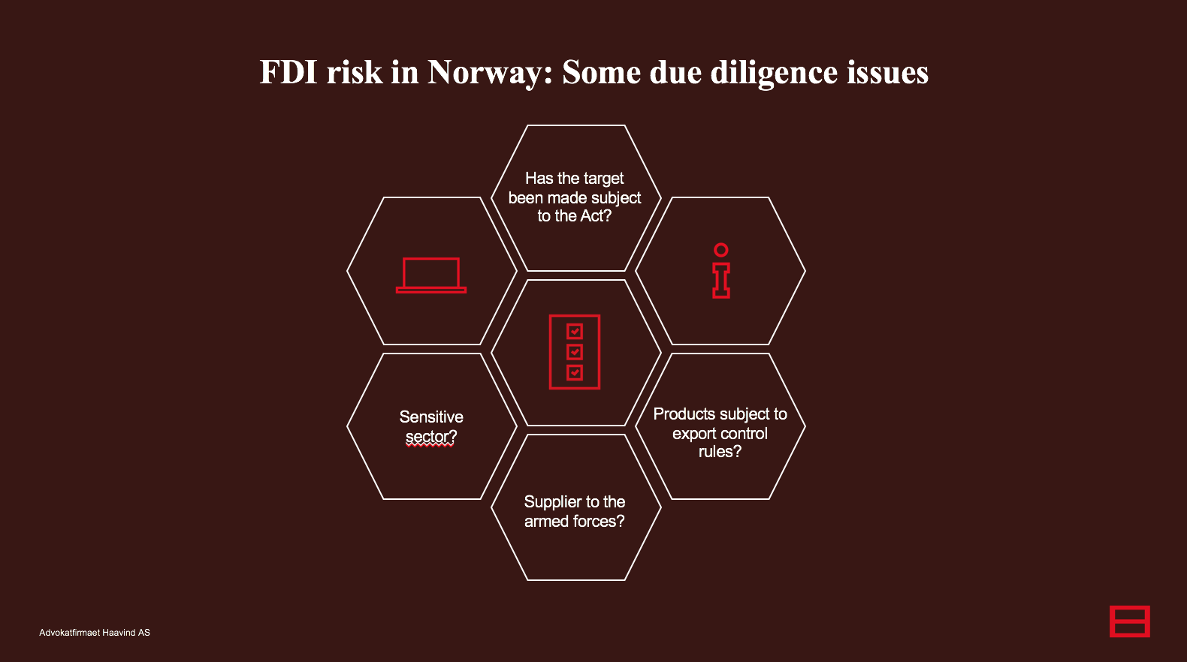




FDI risk in Norway: Some due diligence issues
Has the target been made subject to the Act?
Sensitive sector?
Products subject to export control rules?
Supplier to the armed forces?

Slide 19
FDI SCREENING
IN FINLAND
24 August 2021

Slide 20
Applicable law – “yritysostolaki”
The Act on the Monitoring of Foreign Corporate Acquisitions (172/2012, the “Act”)
Latest amendment came into force on 11 October 2020
Ministry of Economy Affairs and Employment of Finland (“Ministry”) is the responsible authority
A foreign owner
  foreign national / legal entity not established within EU or EFTA Member States
  Legal entity established within EU or EFTA Member States but controlled by the above by at least 1/10
  EFTA = EU + Iceland, Norway, Liechtenstein and Switzerland
Notes:
*the Regulation (EU) 2019/452 of the European Parliament and of the Council of 19 March 2019 establishing a framework for the screening of foreign direct investments into the Union

Slide 21
Background for the proposed new rules
Expanding the scope of application
Changes in international security environment and diversity of security threats
Pandemic was a wake-up call
Notes:
HE 103/2020 VP
https://www.eduskunta.fi/FI/vaski/HallituksenEsitys/Documents/HE_103+2020.pdf
Communication by EU Commission: Guidance to the Member States concerning foreign direct investment and free movement of capital from third countries, and the protection of Europe’s strategic assets, ahead of the application of Regulation (EU) 2019/452
https://trade.ec.europa.eu/doclib/docs/2020/march/tradoc_158676.pdfs/Sivut/HE_103+2020.aspx

Slide 22
WHAT is the law TRYING TO PROTECT?
  Key national interests
    Functions vital to society
    National security
    Authorities’ resources
    Foreign and security policy objectives
  Ownership thresholds
    1/10, 1/3, 1/2
  Ministry can also decide to scrutinize acquisitions in other cases

Slide 23
PROCESS
  Mandatory filing
      Defense industry
      Companies which provide critical goods or services to Finnish authorities
      Non-compliance?
  Voluntary filing
      Other cases
      But Ministry can demand that an application must be made
  Conditional clearance
  Possibility to get a formal exclusion decision

Slide 24
Refusal of approval
  What happens if approval is denied?
    Refusal must be confirmed in the government’s plenary session
    Limited liability companies:
      The foreign owner must dispose of any illegally acquired shares
      Voting restrictions
    Other companies:
      The agreements concerning such shall be void
    Appeal

Slide 25
comments
  Assessment of the threat to a key national interest is always time-dependent and case-specific.
  The law does not list the industries in which companies are subject to monitoring – a conscious choice in Finland.
  “Amendments will not have a significant impact on businesses” ?
Notes:
*Based on the government proposal HE 103/2020 VP

Slide 26
acquisition of real estate by foreigners
  Subject to a permit from the Ministry of Defence
Also in practice we have seen transactions blocked. Municipal sellers typically consult the ministry in advance, to avoid embarrassing negative decisions.
If the real estate purchase is related to business acquisition, the Act (yritysostolaki) applies.

Slide 27
FDI SCREENING
IN SWEDEN
24 August 2021

Slide 28
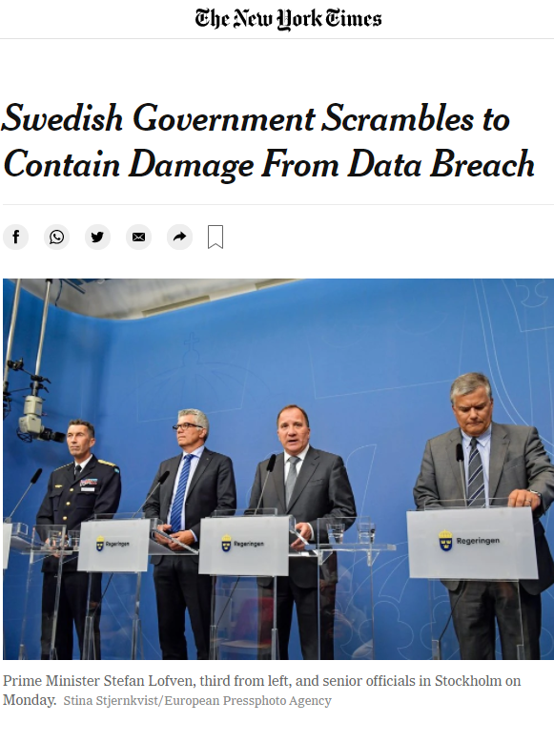
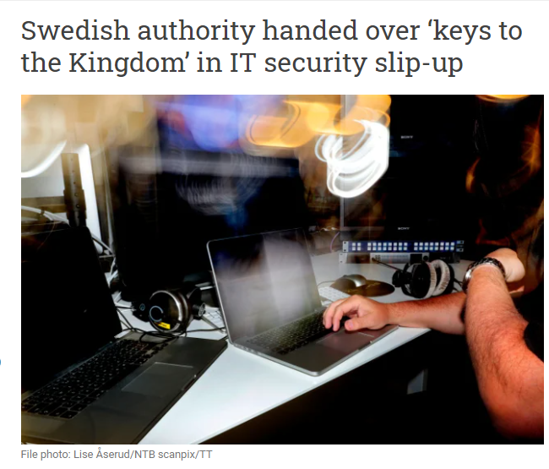

Slide 29

Regulatory framework for fdi in sweden
Sweden has two major initiatives regarding FDI screening
  Amendments to the Protective Security Act entered into force on 1 January 2021
    Fast-tracked initiative, expediated by the COVID-19 pandemic
  Investigation to propose legislation introducing a comprehensive FDI screening procedure and blocking mandate
    The inquiry is set to deliver its proposal in November 2021

Slide 30

Amendments to the Protective Security Act
Implemented on 1 January 2021
The act covers:
  “Whoever is engaged in activities of importance to Sweden’s security or who is otherwise covered by a legally binding international commitment by Sweden regarding protective security.”
  The provisions are not sector-specific
  Applicability depends on the operations of the transferred business
  Some examples are:
  Healthcare, airports, powerplants, information systems, financial services, food supply, and suppliers of vital services

Slide 31


Criteria for review
Introduction of a control mechanism in case of transfers of security-sensitive activities and operations
Pre-authorization requirements before an acquisition can be completed. To conduct and document:
  A security assessment,
  A suitability assessment, and
  Consult with the Swedish Security Service (sw. Säkerhetspolisen) or the Swedish Armed Forces (sw. Försvarsmakten.).
  There is no threshold

Slide 32

Review outcomes and enforcement
The competent authority may decide to:
  Allow the transaction
  Impose conditions
  Block the investment
Means of enforcement is not specified in the amendments, however
  Null and void
  The responsible authority will have a right to order both seller and buyer to take any measures needed to protect Sweden’s security, under the penalty of a fine

Slide 33

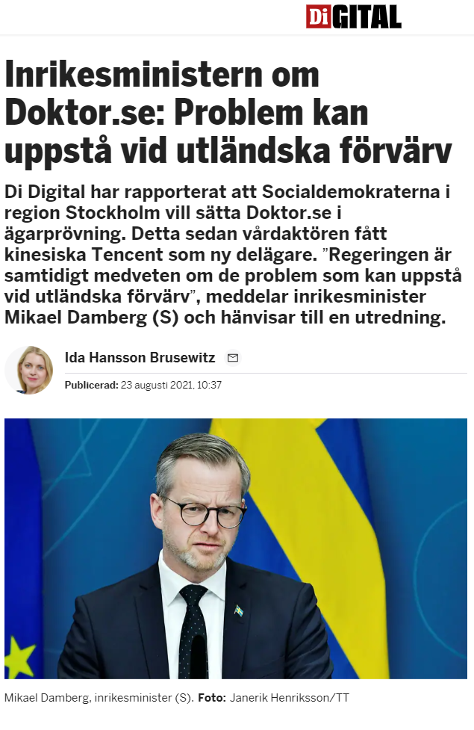
Regulatory framework The second initiative
  Investigation to propose legislation introducing a comprehensive FDI screening procedure and blocking mandate
    The inquiry is set to deliver its proposal in November 2021

Slide 34
comments
  The legislator has intentionally kept the scope of the regulation flexible
  The suggested amendments contain no set time limit for the consultation process
  There are no set screening thresholds
  Sweden is currently preparing for a more comprehensive FDI screening scheme
    The Swedish Government say they maintain a positive attitude towards foreign investments

Slide 35
FDI SCREENING
IN DENMARK
24 August 2021

Slide 36
Background
2013-18 foreign direct investment into Denmark at approx. DKK 3,850bn or 30.9% of GDB (of which approx. DKK 2,912 or 23.3% of GDP comes form EU)
Denmark has wanted to introduce a ”robust” screening system in the ”more restrictive end” of what is seen in the EU
Why such a restrictive system?
  Huawei and Chinese investments in general
  Middle East investment funds
  Russia
  Sale of Danish State’s vaccine production facility to Saudi buyer
  PE fund ”tax haven” investments

Slide 37
Background
Denmark: From open econiomy to Robust fdi screening system in the very Restrictive end of what is seen in the EU
Existing rules
War material
Continental shelf
Telecom infrastructure
Radio frequencies
Financial businesses
Dynamic legislation
Adaptable to changes in what is perceived to be within ”national security” and ”public order”, e.g. for industries impacted by Covid19
Key issues
  Lack of control over supply chains
  Foreign monopoly over key infrastructure
  Tech-transfer risks

Slide 38
Trawling where flyfishing is required…?
  Confederation of Danish Industries (DI) and Danish Chamber of Commerce (Dansk Erhverv):
  ”all in all too protectionistic”
    application to investments from EU and OECD countries
    too wide and unspecific definition of relevant ”critical” sectors
    no lower threshold on size of investments

Slide 39
Legislative process
Based on report from cross-ministerial working group established by former Liberal/Conservative government and taken over by the Socialdemocrat government
Voted through with support from all major political parties in Denmark)
Much guidance to be found in executive orders (bekendtgørelser)
Law adopted
Entry into force
Applies to all transactions completing from
Executive orders issued:
Area of application
Application guidance
Confidential information
4 May 2021
1 July 2021
1 September 2021

Slide 40
What are we trying to protect?
National security
    Territiorial integrity
    Survival of the population
    ”Harm to Denmark”, e.g. threats to or crimes against central public authorities - in Denmark or other EU countries
    Interupt international relations / peaceful co-existence between nations
    Military threats
Public order
Challenge to Denmark as a free, independent and democratic country
Prevent, uncover and counteract behaviour threatening security
Security measures implemented in accordance with basic legal principles and values
Public health
Other issues of ”significant” public importance - in Denmark or other EU countries

Slide 41
Who are foreigners?
The ”real” ownership structure is decisive. Aggregation of common ownership or voting rights.
Any foreign person and (almost) all foreign legal entities
Foreigners based in EU, EEA and OECD included
A foreigner with residence permit and/or permanent establishment in denmark
INTELLECTUAL PROPERTY
Only “true” eu / EEA companies as concerns special economic agreements
Danish company with foreign ultimate business owner (including VC/PE funds)
“access to influence” or “control”
Similar to ubo test: 25%, decision or veto rights, director appointment, etc.)
Non-EU/EAC association and non-commercial trust etc.
DUAL Danish and foreign citizenship
Non-EU/EAC national authorities and investment funds
(Example: the norwegian oil fundis not comprised when investing directly, but not excempted when through a subsidiary

Slide 42
Critical sectors
No lower limit
=
if you have 1% revenue in a critical sector, you are critical sector
If you are supporting (DK: understøtter) critical infrastructure
=
all suppliers to critical infrastructure
Very broadly defined

Slide 43
Critical sectors
Defense
IT security
Dual-use products
AI / machine learning
Nuclear technology
Nano-technology
INTELLECTUAL PROPERTY
Semi-conductors
3D print
Cyber security
Space and aero-tech
Power to X technology
Advanced industrial robots
Regarding critical technologies, NOT...
if technology is developed or manufactured for consumer products that are widely available (e.g. toys and consumer goods for home use)
Biotech (synthetic biology)
Transport infrastructure
IT infrastructure
Emergency services and civil protection
Energy infrastructure
X
Quantum technology
Sewage water and renovation
Financial infrastructure
Public authorities
Meteorology
Health infrastructure
Food and drinks infrastructure
Public crisis management

Slide 44
Critical infrastructure
Investment in or ”special economic agreement” with entity
  with direct or indirect ownership, operational responsibility according to agreement for (outsourcing) or that has public authority responsibility for critical infrastructure
  that develops or manufactures technologies or products that constitutes or otherwise supports (Danish word: understøtter) critical infrastructure
Processes
Facilities
Systems
Xx
… that are necessary to uphold or restore functions important to the society
Xx
Services
Networks
Technologies
Assets

Slide 45
Specific case
Question
I anvendelses-bekendtgørelsens § 11, stk. 3 fremgår det, at kritisk infrastruktur omfatter virksomheder og enheder efter § 3, der understøtter de samfundsvigtige funktioner der følger af nr. 1-11 i samme stk. 3. Hvad betyder ”understøtter” i den sammenhæng? Vil fx en virksomhed, der leverer komponenter til kritisk infrastruktur, der om end en sådan komponent (i) kan substitueres med en konkurrents komponent og (ii) selvom en sådan komponent ikke udgør en væsentlig fysisk eller finansiel andel af en ”facilitet” dog er nødvendig for at få denne facilitet til at virke, blive opfattet som en virksomhed indenfor kritisk infrastruktur?
Answer
… vores opfattelse, at virksomheder, der leverer komponenter til andre virksomheder inden for kritisk infrastruktur, også selv vil kunne blive udpeget som kritisk infrastruktur i kraft af dette.

Slide 46
Investment transactions
Control of share ownership or voting interest
From 0 to 15% and then afterwards from 15% to 25% requires two applications
No lower monetary threshold
Percentage calculation includes shares directly and indirectly controlled by the foreigner or shares which the foreigner may influence through ownership by closely related parties (IAS 24)
Ownership percentage(s) to be calculated for each entity in an ownership structure
Intra-group reorganisations where ultimate owner remains the same are excempted
10%
20%
1/3
50%
2/3
100%
Xx
Xx

Slide 47
Investment transactions
No general minimum economic thresholds where FDI screening is not relevant.
Control over or “access” to voting rights
Take, veto or approve decisions on material financial, operational, managerial and/or development issues
Control via articles of association
INTELLECTUAL PROPERTY
Joint control over voting rights with other investors, e.g. via shareholder agreements or concerted practice
Right to appoint or remove members of the board of directors and/or the executive management
Control via long-term or unterminable agreements, including loan agreements and lease contracts
“Potential” voting rights (warrants / options) eligible for exercise
Extraterritorial effect – applies to offshore transactions where control over a Danish company shifts
Assets deals, e.g. Concerning IPR, other key components or structures and real estate
Greenfield investments – if new entity becomes subsidiary or if investment above EUR 10m
Applies to acquisition of shares in or control over listed companies

Slide 48
Investment transactions
Exceptions
Start-ups may during first 3 years receive up to DKK 75m (EUR 10) from each foreign investor as long as the DK entity does not become a subsidiary of (any) the investor(s)
  Pledge of shares, voting rights or assets as security for debt or creditor prosecution with a view to realisation of the secured assets are not transactions relevant for FDI screening
Intra-group transactions are not relevant if they do not lead to an increase in ownership beyond the thresholds or other increase in ”similar control”

Slide 49
Special economic agreements
Approval only necessary for non-EU entities
  not relevant if ”control” is inside Denmark or EU, but only ”true” DK/EU entities not controlled from abroad
    applies to a non-EU company owned by a Danish citizen
    applies to EU company controlled (25% ownership) by non-EU foreigner
General requirement that such agreement a foreign gains ”control” or ”significant influence”
Merely an access to information is not sufficient
Operational and service (outsourcing) agreements
R&D joint ventures
Supply agreements

Slide 50
Other tracks
General track (outside critical sectorS)
Control over +25% of a Danish business
Any non-EU entity, including any EU entity controlled by a foreign person or entity
If approved, Danish authorities waive the access to review and reverse a transaction, which otherwise applies for up to 5 years after completion
You can proceed without application or pending application
Pre-screening
Danish Business Authority can issue confirmation that contemplated transaction is not relevant under the FDI regime
Application to be submitted by foreigner, Danish entity on behalf of foreigner or after 3 years’ life by Danish entity

Slide 51
Obligations in case of relevant fdi
Critical sectors
Gun-jumping prohibition = implementation prohibitition (similar to merger control)
Application to Danish Business Authority is the obligation of the foreigner
Danish Business Authority can (i) approve or (ii) approve with conditions, including such that can be agreed with buyer through negotiations, but in a ”no approval” case matter needs to be referred to the Danish Ministry for Industry, Business and Financial Affairs
Voluntary track
No obligation to apply
Application to Danish Business Authority is the obligation of the foreigner
Approval eliminates the review and reversal right for the Danish authorities that otherwise applies for 5 years after completion

Slide 52
Application formalities
Submission of application via digital system
If to be submitted by lawyer, documentation for authority to do this must be submitted
To cater for shorter case handling period complete yourself the EU notification
INTELLECTUAL PROPERTY
Based on application forms issued by the danish business authority
60-day review period
For critical sector filings no automatic approval at the end of the 60-day period – case handling may be prolonged in case of further information requests, delays etc.
In Voluntary scheme approval is automatic if no response at the end of 60-day period
Rules on protection of information submitted, but no information access
Danish or english
Approval may be revoked later if subsequent changes imply serious threats to national security or public order (e.g. Territotial changes, military coup takeover

Slide 53
Reasons to reject an fdi
The FDI target
  Danish entity operates within or transaction influences Danish infrastrucure
  Access to or processing of classified personal data
  Supply of critical ”raw materials”, including energy and food supply safety
  Special focus on defense industry, dual-use product manufacturers and critical technology
  Market position, including substitution potential
The foreign party
  Direct or indirect controlled by foreign governments, organs or army forces, including through ownership or financing
  Involved in activities influencing national security or public order in EU or other allied countries
  Involved in or relationship to criminal activities
  Attempting to circumvent screening rules

Slide 54
remedies
Danish Busines Authority may revoke voting rights on shares
Shares acquired against the rules are not counted towards voting computations
Special economic agreements entered into without approval are null and void
Access to exproriation
Access to premises without search warrant
No penal consequences (fines, imprisonment)

Slide 55
Challenging a negative ruling
To be logded with 6 months from ruling
Court appoints a special attorney to act on behalf of foreign party, who may not share information with applicant
Access to information may be limited due to national security and/or public order concerns

